Slide 1
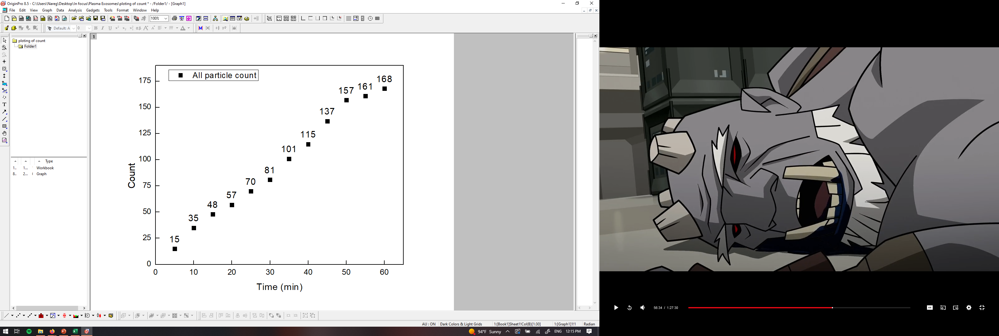
PANORAMA of mouse 44 (5-5-2022)
Time: 60 min
Count: 168 (Ex: 111; Large: 57)
Time: 60 min wash
Count: 45
Note: 0 % response to miRNA-21
0% response for GFP
Scale bar: 10 µm

Slide 2

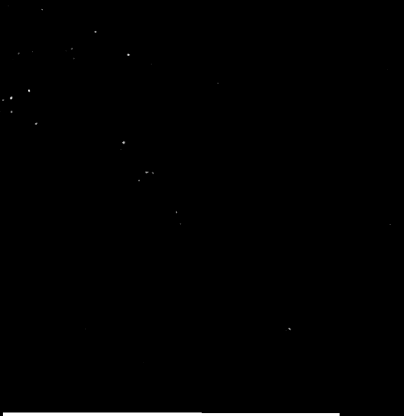
PANORAMA of mouse 44 (5-12-2022)
Time: 60 min
Count: 288 (Ex: 207; Large: 81)
Time: 60 min wash
Count: 29
Note: 0 % response to miRNA-21
0% response for GFP
Scale bar: 10 µm

Slide 3


PANORAMA of mouse 44 (5-19-2022)
Time: 60 min
Count: 416 (Ex: 346; Large: 70)
Time: 60 min wash
Count: 73
Note: 15 % response to miRNA-21
0% response for GFP
Scale bar: 10 µm

Slide 4

PANORAMA of mouse 44 (5-28-2022)
Time: 60 min
Count: 632 (Ex: 496; Large: 136)
Time: 60 min wash
Count: 206
Note: 58 % response to miRNA-21
4 % response for GFP
Scale bar: 10 µm

Slide 5
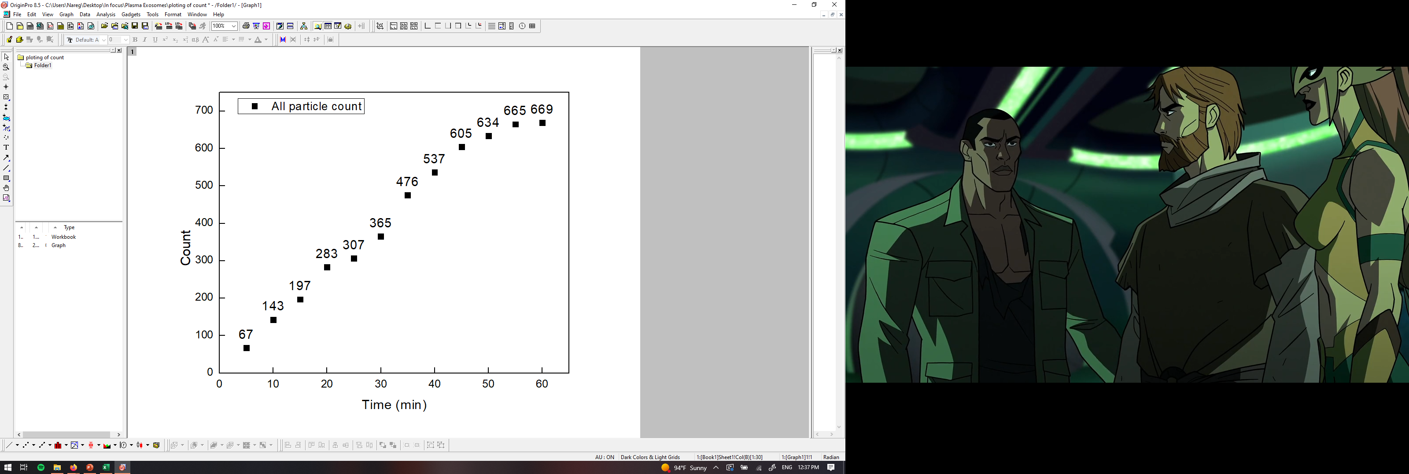
PANORAMA of mouse 44 (6-5-2022)
Time: 60 min
Count: 669 (Ex: 537; Large: 132)
Time: 60 min wash
Count: 254
Note: 37 % response to miRNA-21
6 % response for GFP
Scale bar: 10 µm

Slide 6
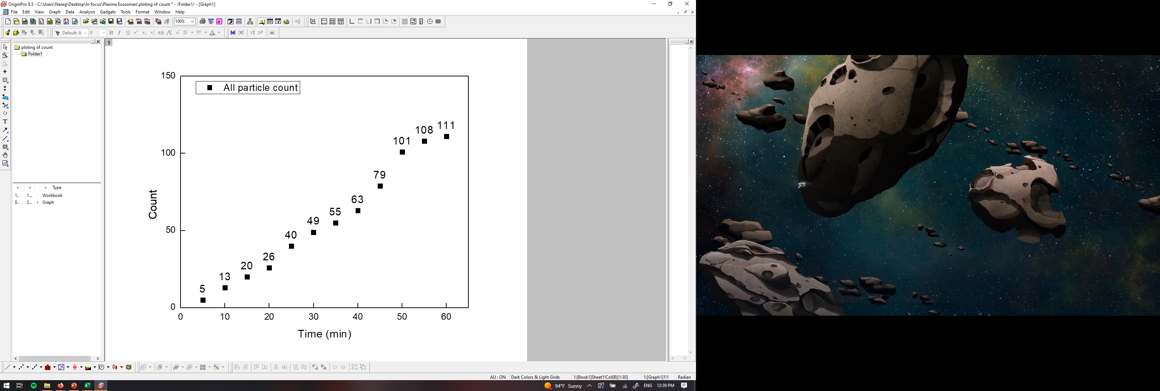
PANORAMA of mouse 45 (4-28-2022)
Time: 60 min
Count: 111 (Ex: 53; Large: 58)
Time: 60 min wash
Count: 24
Note: 0 % response to miRNA-21
0 % response for GFP
Scale bar: 10 µm

Slide 7
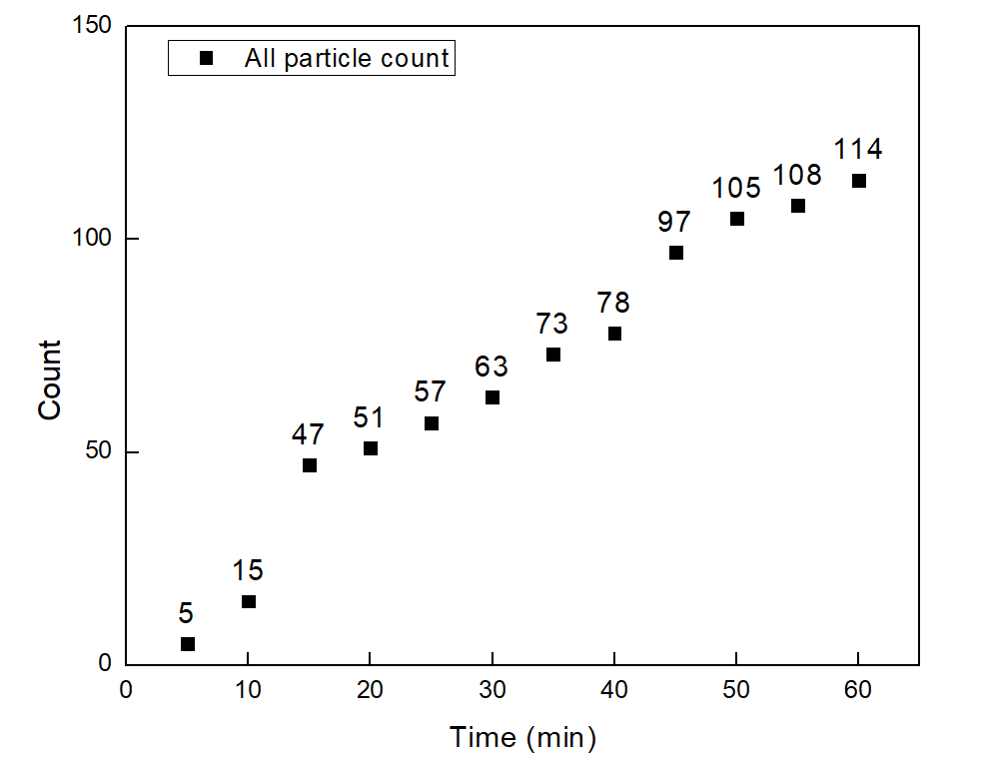
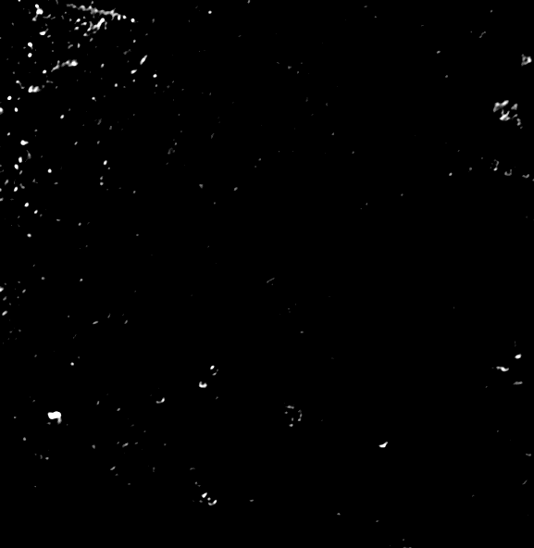

PANORAMA of mouse 45 (5-5-2022)
Time: 60 min
Count: 114 (Ex: 87; Large: 27)
Time: 60 min wash
Count: 27
Note: 0 % response to miRNA-21
0 % response for GFP
Scale bar: 10 µm

Slide 8
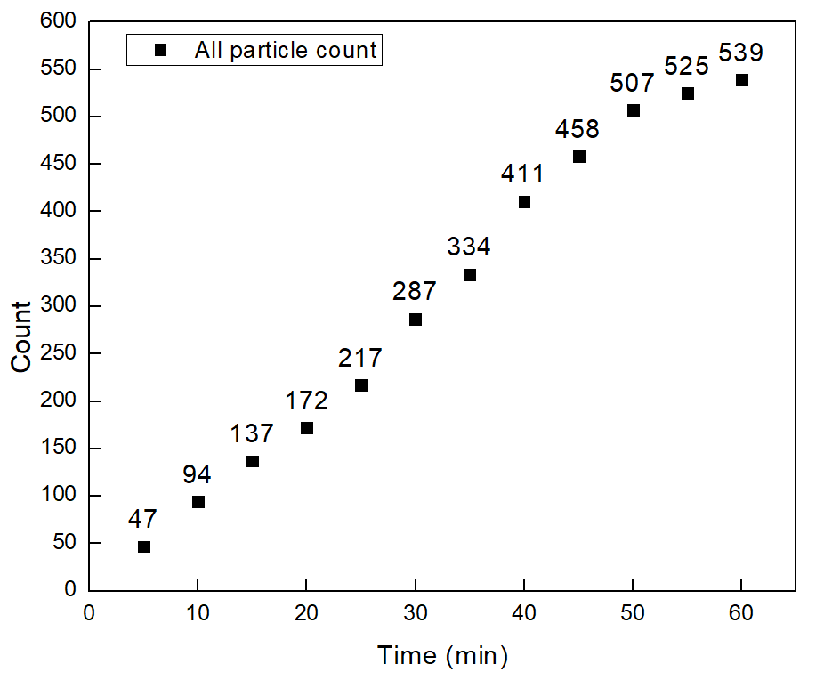
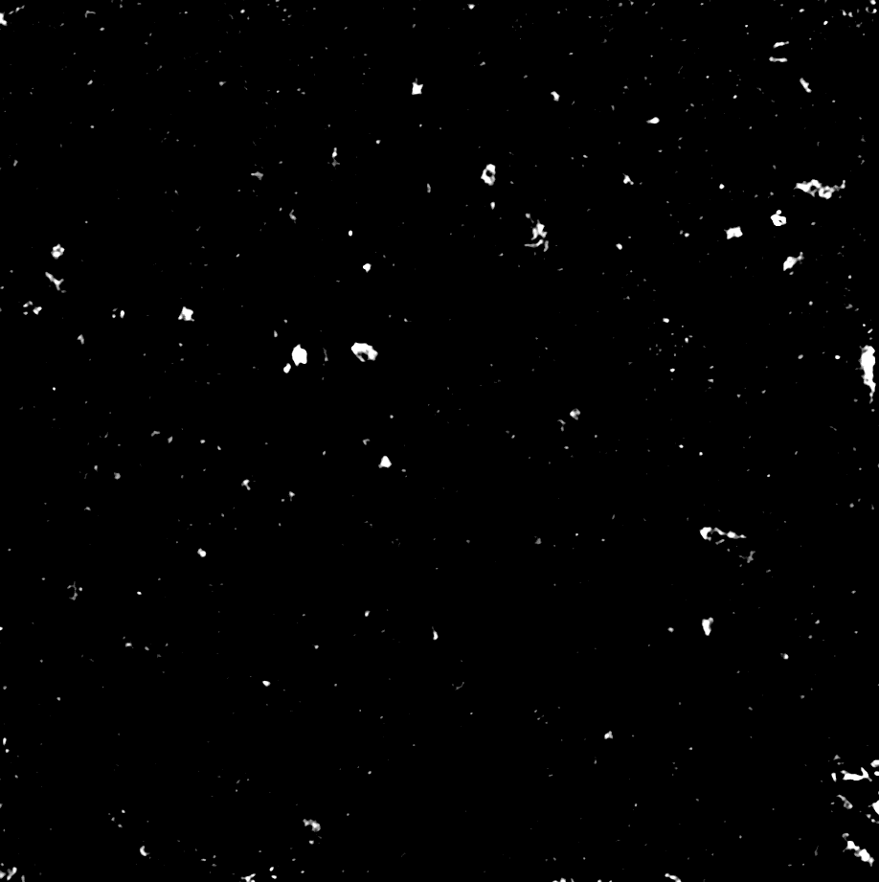
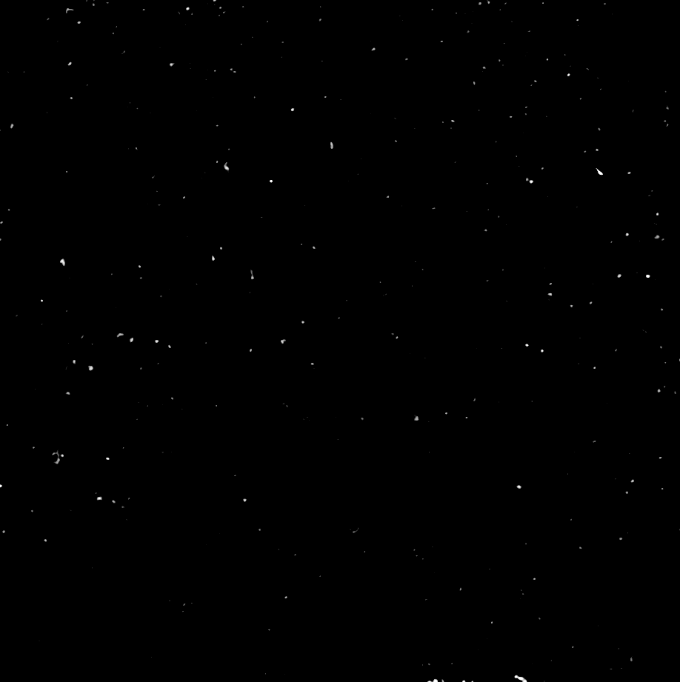
PANORAMA of mouse 45 (5-12-2022)
Time: 60 min
Count: 539 (Ex: 431; Large: 108)
Time: 60 min wash
Count: 260
Note: 17 % response to miRNA-21
6.9 % response for GFP
Scale bar: 10 µm

Slide 9
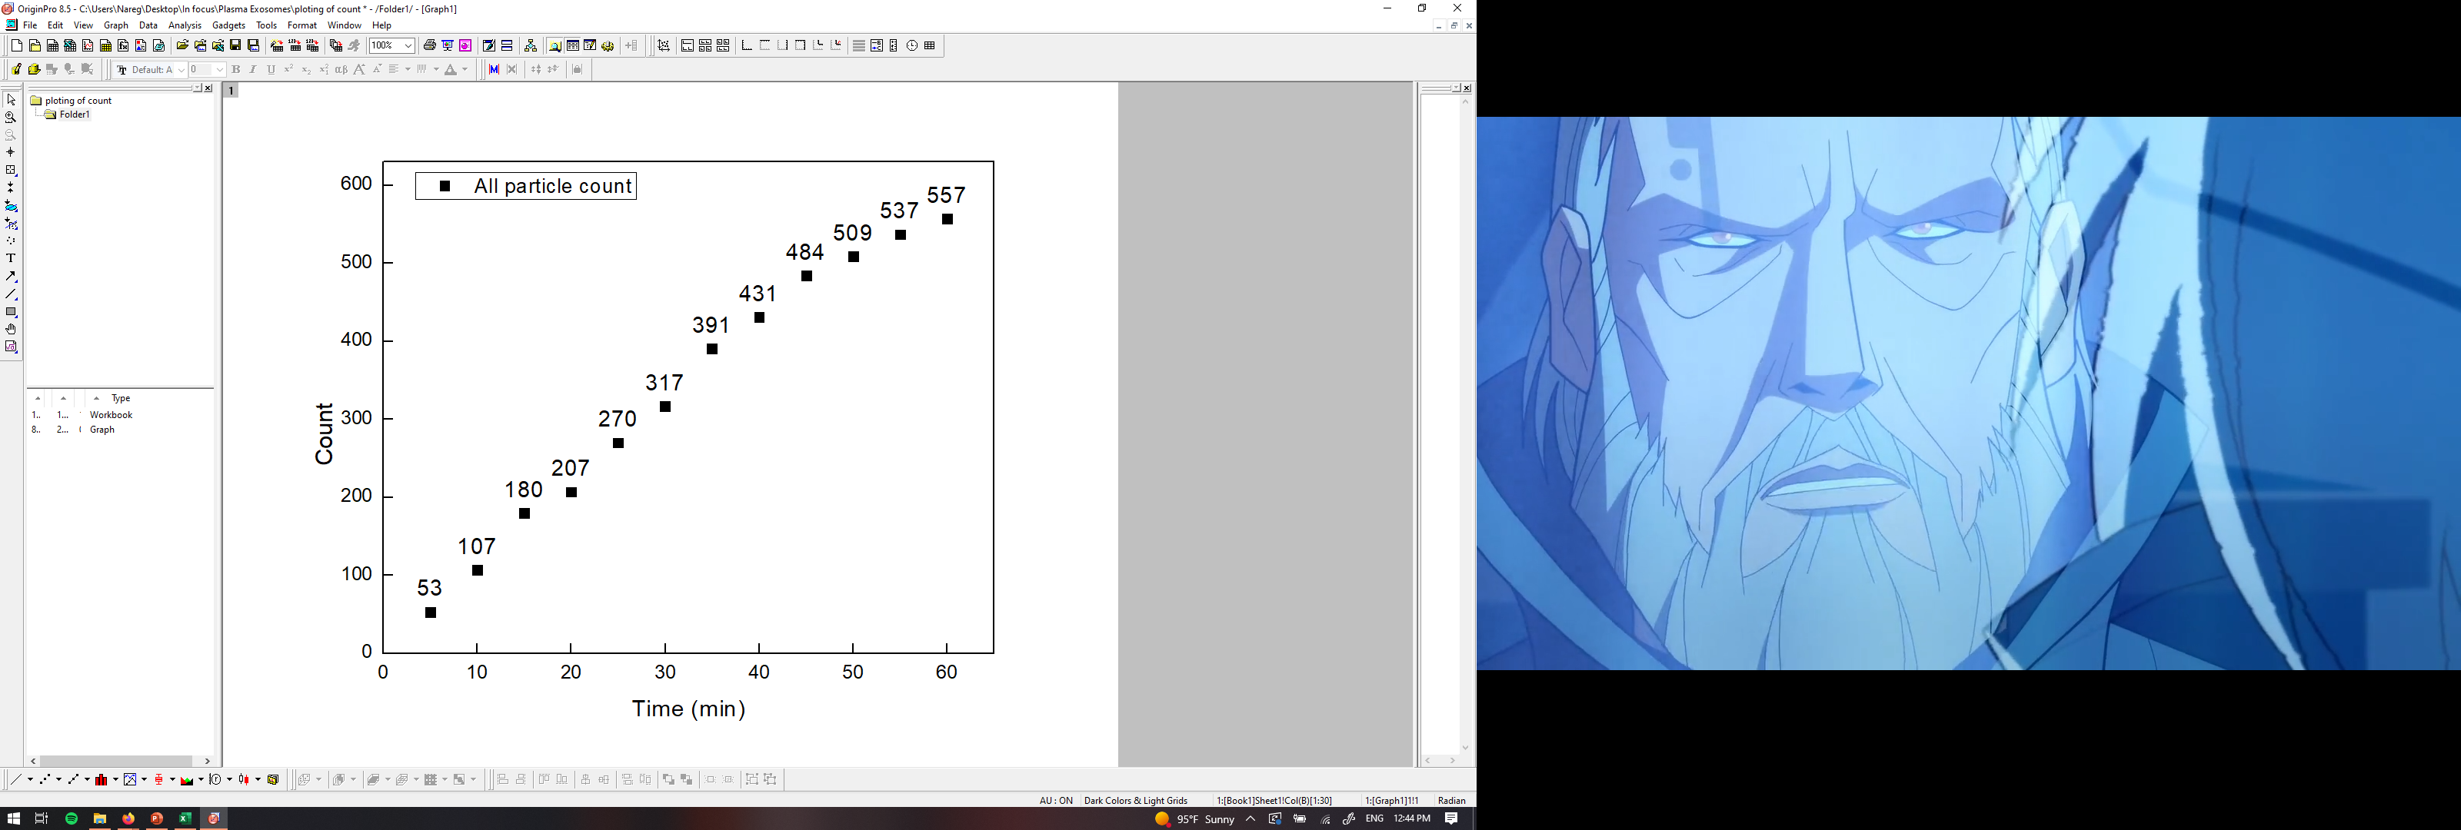
PANORAMA of mouse 45 (5-19-2022)
Time: 60 min
Count: 557 (Ex: 479; Large: 78)
Time: 60 min wash
Count: 237
Note: 63 % response to miRNA-21
2 % response for GFP
Scale bar: 10 µm

Slide 10
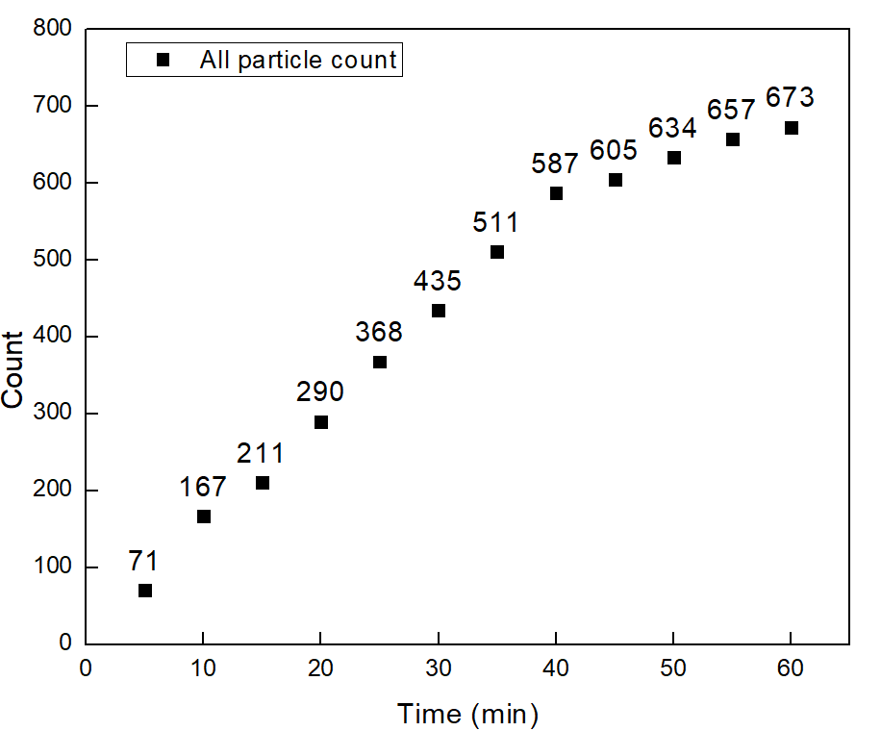
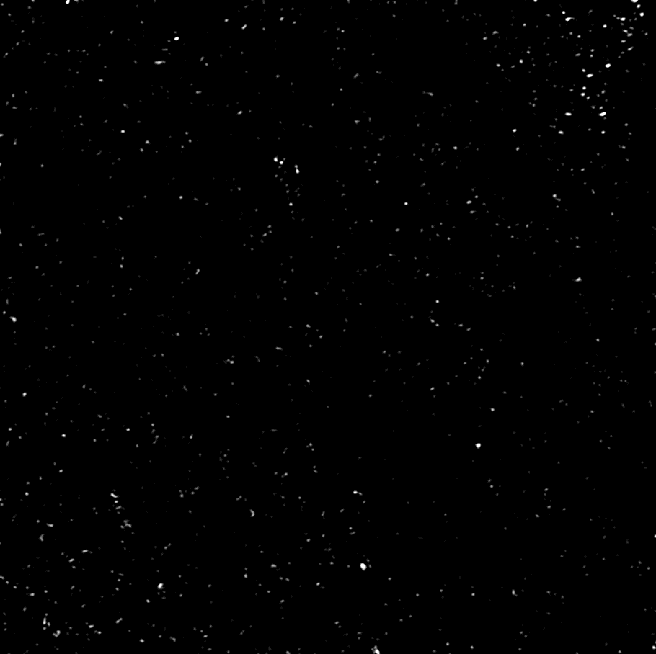
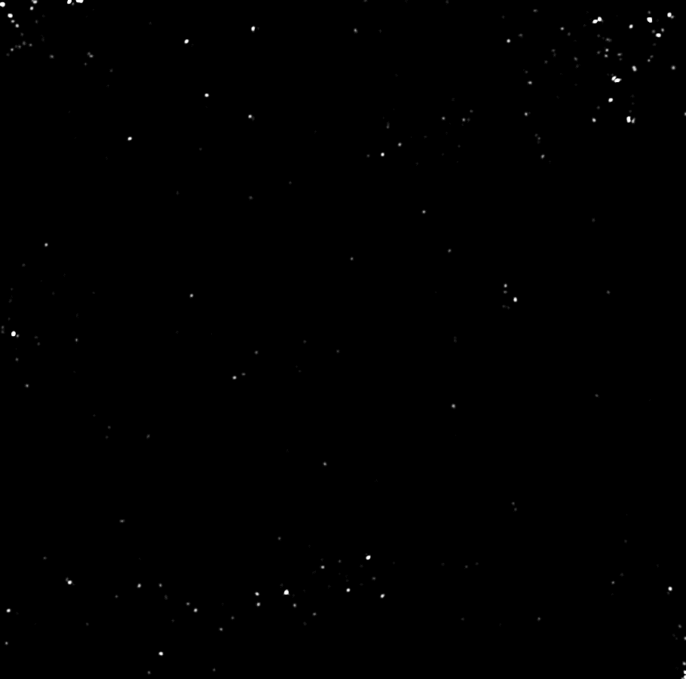
PANORAMA of mouse 45 (5-28-2022)
Time: 60 min
Count: 673 (Ex: 579; Large: 94)
Time: 60 min wash
Count: 231
Note: 51 % response to miRNA-21
5.6 % response for GFP
Scale bar: 10 µm

Slide 11
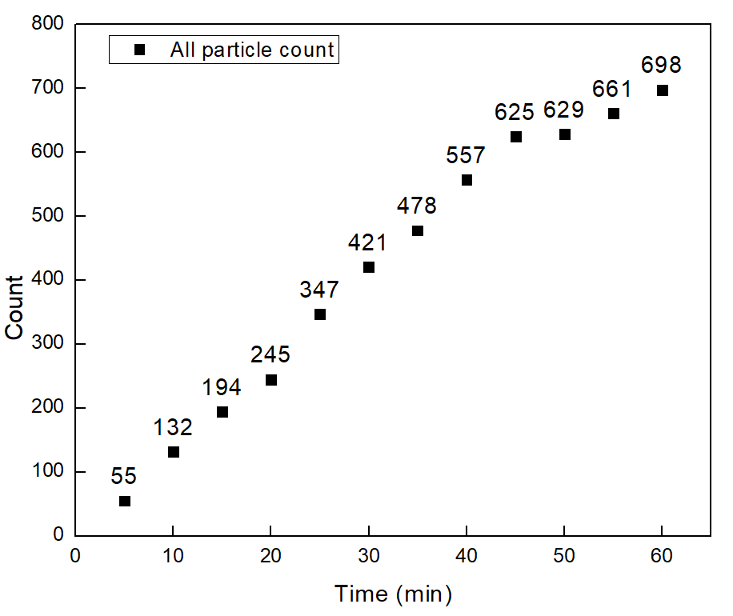
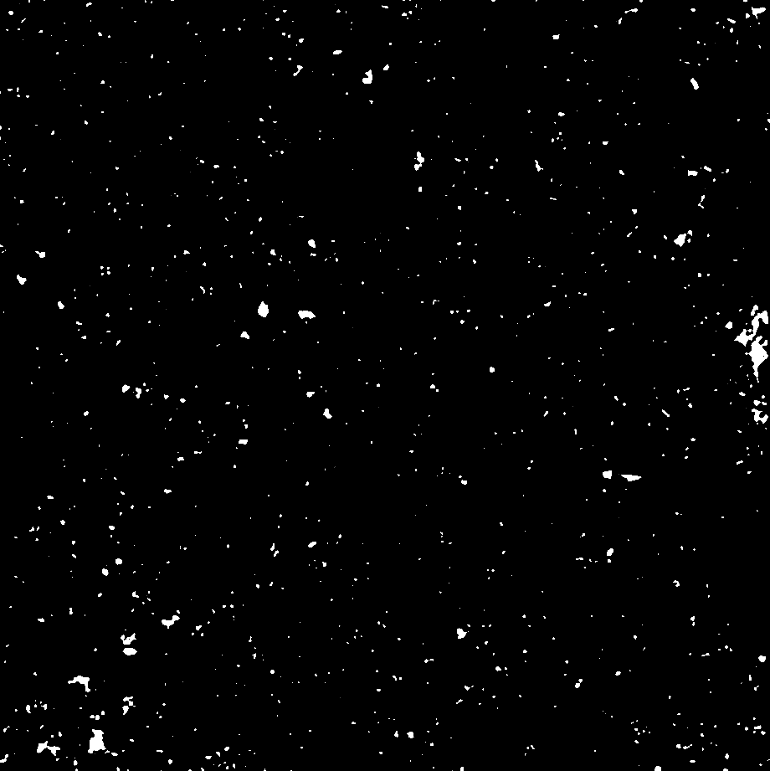
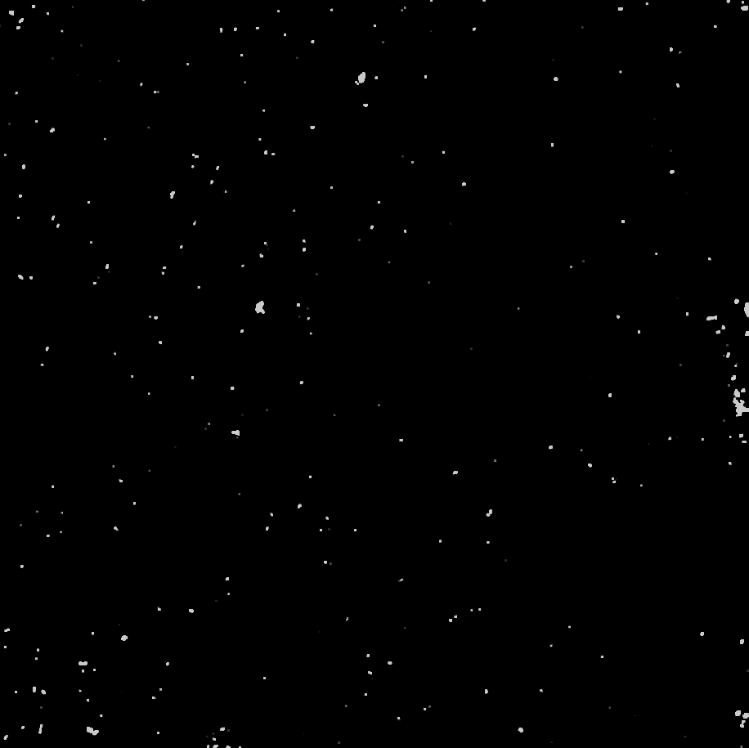
PANORAMA of mouse 45 (6-5-2022)
Time: 60 min
Count: 698 (Ex: 500; Large: 198)
Time: 60 min wash
Count: 255
Note: 37 % response to miRNA-21
2 % response for GFP
Scale bar: 10 µm

Slide 12
All particle count from 10 mouse plasma
All particles count
Mouse | Week 0 | Week 1 | Week 2 | Week 3 | Week 4 | Week 5
#36 | 248 | 117 | 138 | 159 | 192 | 182
#37 | 27 | 69 | 97 | 14 | 40 | 342
#38 | 67 | 237 | 287 | 408 | 470 | 539
#39 | 48 | 214 | 271 | 445 | 289 | 414
#40 | 193 | 360 | 404 | 378 | 587 | 545
#41 | 86 | 299 | 191 | 319 | 375 | 331
#42 | 194 | 291 | 969 | 813 | 695 | 772
#43 | 248 | 459 | 277 | 433 | 766 | 1052
#44 | 134 | 168 | 288 | 416 | 632 | 669
#45 | 111 | 114 | 539 | 557 | 673 | 698

Slide 13
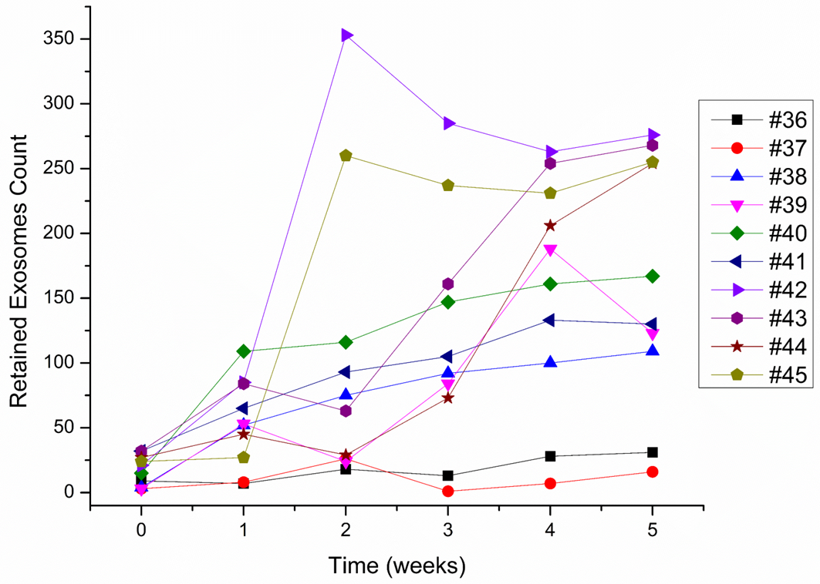
Retained exosome count from 10 mouse plasma
Retained Exosomes Count
Time | Week 0 | Week 1 | Week 2 | Week 3 | Week 4 | Week 5
#36 | 9 | 7 | 18 | 13 | 28 | 31
#37 | 3 | 8 | 26 | 1 | 7 | 16
#38 | 4 | 52 | 75 | 92 | 100 | 109
#39 | 3 | 53 | 24 | 84 | 188 | 123
#40 | 15 | 109 | 116 | 147 | 161 | 167
#41 | 32 | 65 | 93 | 105 | 133 | 130
#42 | 21 | 85 | 353 | 285 | 263 | 276
#43 | 32 | 84 | 63 | 161 | 254 | 268
#44 | 27 | 45 | 29 | 73 | 206 | 254
#45 | 24 | 27 | 260 | 237 | 231 | 255

Slide 14
MIR-21 occurrence among retained exosomes
MIR-21 Occurrence
Time | Week 0 | Week 1 | Week 2 | Week 3 | Week 4 | Week 4
#36 | 0 | 0 | 0 | 0 | 0 | 0
#37 | 0 | 0 | 0 | 0 | 0 | 0
#38 | 0 | 27.5 | 46 | 33.7 | 59.5 | 48
#39 | 0 | 0 | 23 | 41 | 39 | 54
#40 | 0 | 35 | 40 | 39 | 43 | 45
#41 | 0 | 0 | 29 | 45 | 41.3 | 39
#42 | 0 | 0 | 56 | 38.5 | 41 | 46
#43 | 0 | 5 | 31 | 35 | 41 | 45
#44 | 0 | 0 | 0 | 15 | 58 | 37
#45 | 0 | 0 | 17 | 63 | 51 | 37

